Slide 1
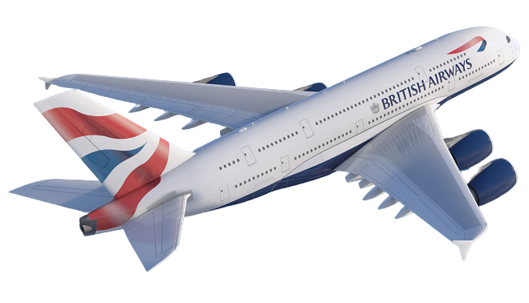
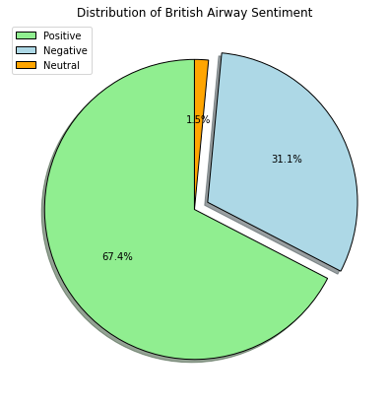
British Airways Review Analysis
Sentiment Analysis:
Positive sentiment for British Airway accounts for more than 70% of all reviews.
Negative sentiment just around 30%.

Slide 2
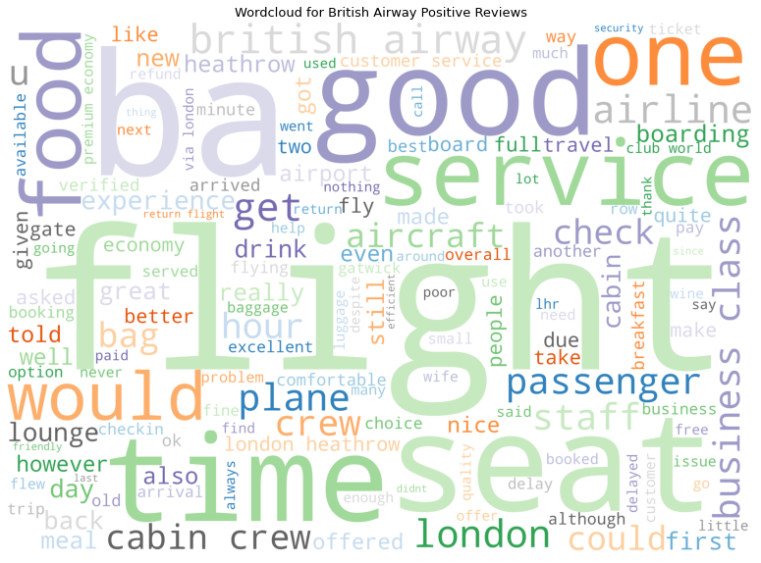
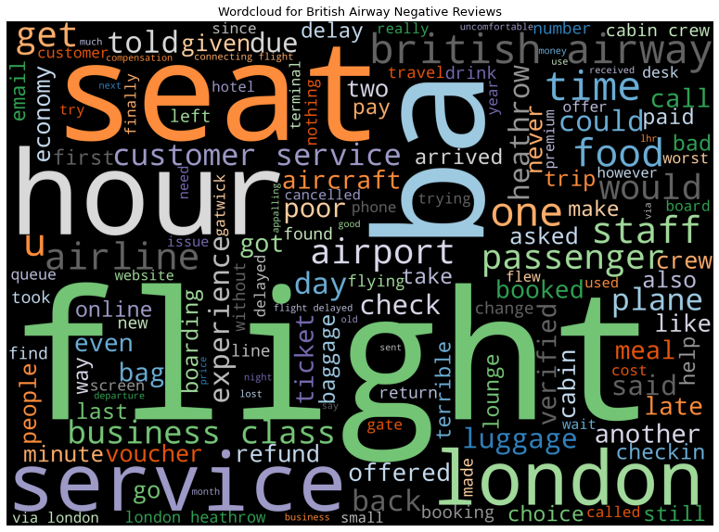
British Airways Review Analysis
Wordcloud Visualization:
From the wordcloud for postive reviews, we can see that the most frequently words are time, good, Ba, seat, customer service, staff, crew, food.
For the wordcloud for negative reviews, service, hour, check, luggage, passenger, refund, london appear the most.

Slide 3
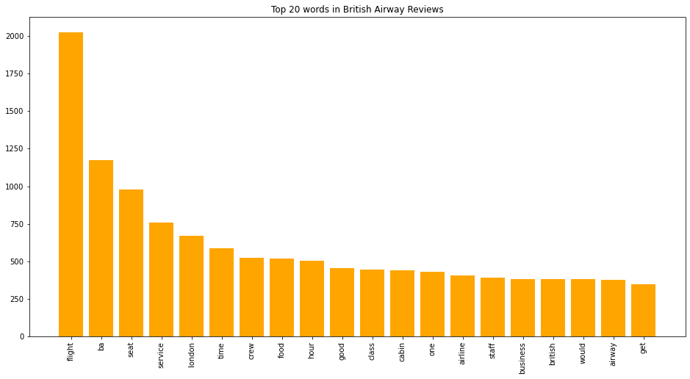
British Airways Review Analysis
Key Topics:
The frequent chart below shows the key topics within reviews include: seat, service, time, food, class, business, this implies that users frequently talk about their experience and food.

